Slide 1
uPark Lot Finder
Group 3:
Brandon Jolley - Lead Java Dev
Ethan Bailey - Lead Creative Designer
Kaleb Dutson - Lead Firebase Dev
Max Thomas - Lead Activity Designer

Slide 2
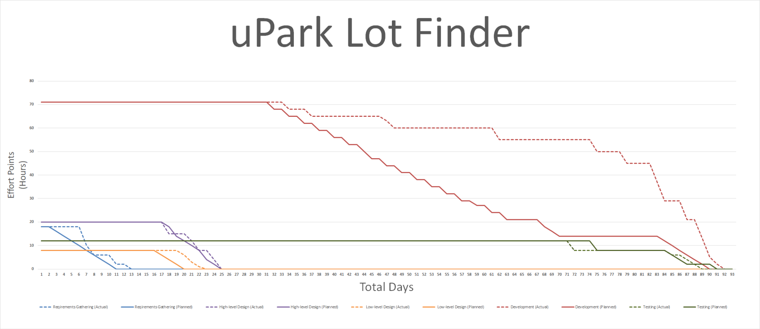

Slide 3
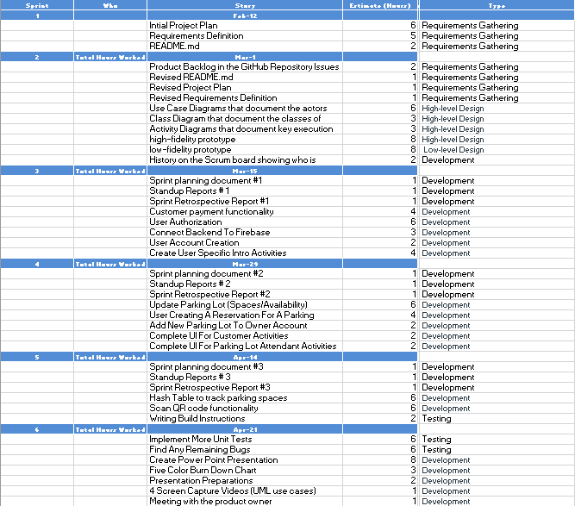

Slide 4
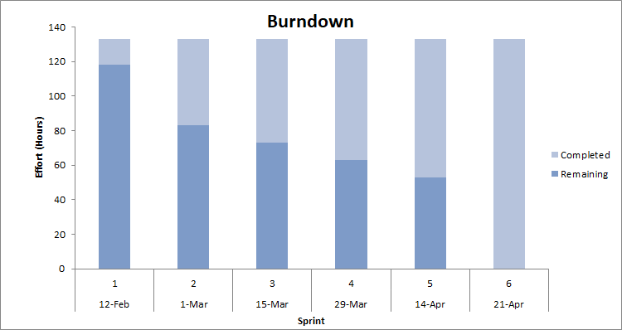

Slide 5
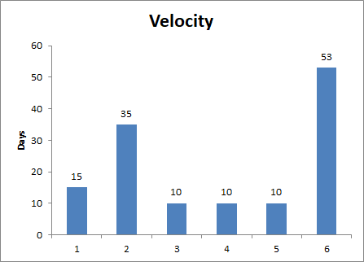

Slide 6
When we started planning for this project, we designed a web app with a Java backend and a Java web server. We underestimated how difficult it would be to program a web server from scratch, so we began brainstorming solutions.
Our second plan was to use the MySQL database to store backend information, with a JavaFX app as the frontend. After spending several hours, we realized that it would be too complex to learn for the time that we had left to complete the project.
After some deliberation on whether we should change gears again, the team chose to design an Android app since we were more comfortable creating an Android app than a web app. This is mainly due to the fact that most of us are currently taking CS 3200 (Mobile App Development).
Our change ended up being a great decision, as we made progress very quickly. We made up a lot of lost ground in the last two weeks of Milestone 3, and spent Milestone 4 polishing the app up for presentation.
Design Difficulties and Solutions

Slide 7
Requirement 1
Owner creating and altering details of their parking lot

Slide 8
Low-fi and High-fi Design
We started by defining the requirement.
We needed the owner user to be able to create parking lots for other users to interact with.
We thought about adding a way for the owner to add bank information to transfer funds.
We knew that for simplicity with the database, the owner couldn’t own/manage more than one parking lot at a time.
We created a basic UML and and plotted out the use case in our design phase. We also planned out the various phone activities we would use to allow the user to intuitively interact with the application.
Finally, we planned how the database would store different pieces of information to later be accessed by other users and activities.

Slide 9
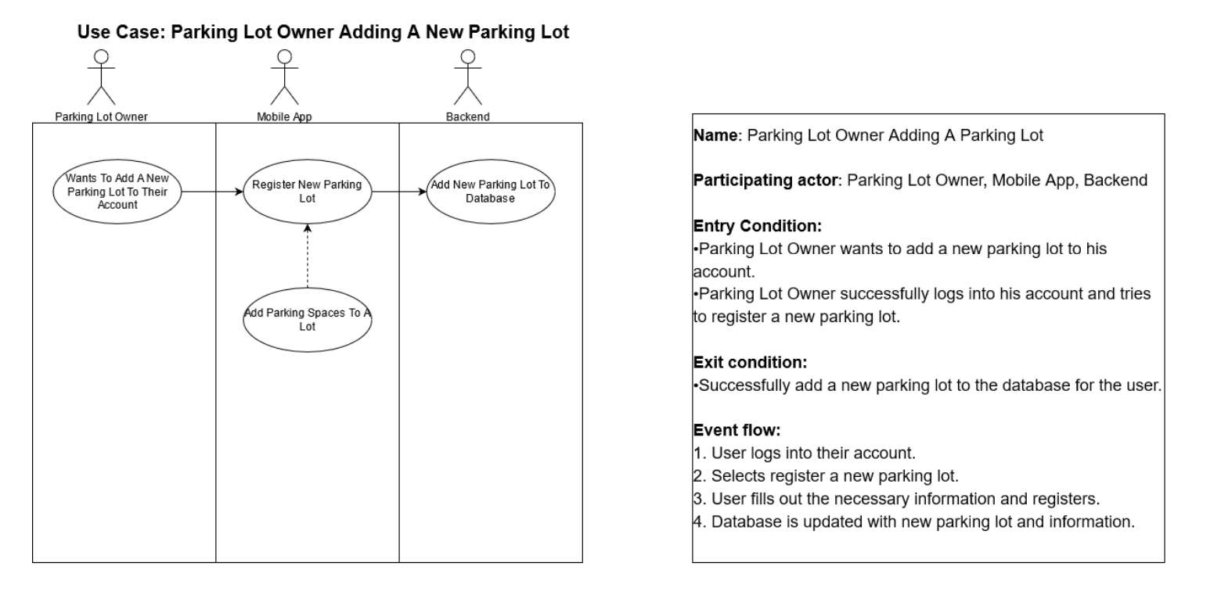
Use case Diagram/UML

Slide 10
Development and Scrum Meetings
Development Tasks:
Design and develop owner activities - (Assigned to: Brandon and Kaleb)
We developed two phone activities that an owner user can interact with; The OwnerMain and the ManageLot. The OwnerMain contains an overview of parking lot and account balance information. The ManageLot allows the owner to create a lot, or alter details of an existing lot.
Buttons to transfer between the activities - (Assigned to: Brandon)
Created the manageLot button to launch the ManageLot activity and the returnToMain button to go back to the OwnerMain activity.
Allowing owner to create parking lot - (Assigned to: Brandon and Kaleb)
Created multiple EditTextFields that allow the user to input important data about the parking lot like price, number of spaces, location, etc. Created a submitLot button that pushes the lot information to the database.
Load owner data from the database to the OwnerMain and ManageLot activities - (Assigned to: Kaleb)
Retrieve the data from the database to display.
Button to logout of user account - (Assigned to: Brandon)
Created a button that can take the user back to the login screen and secure the sensitive user information.
Keep track of owner account balance - (Assigned to: Kaleb)
Created a textView that displays the most current owner account information in dollars.
Scrum Meetings:
In our scrum meetings, we discussed how to utilize the Google Firebase database to best store the details of the parking lots. We also talked about how to best implement and split up the various interactive components (buttons, edit text fields) between the two activities.
Unit Testing:
For unit testing we placed System Log messages at “weak points” and areas where we were still developing to interpret the errors we were getting. Most of the time, the errors involved the database, and we were able to track nullPointerExceptions when we referenced a database object before it was stored in the database, or many other similar issues.

Slide 11
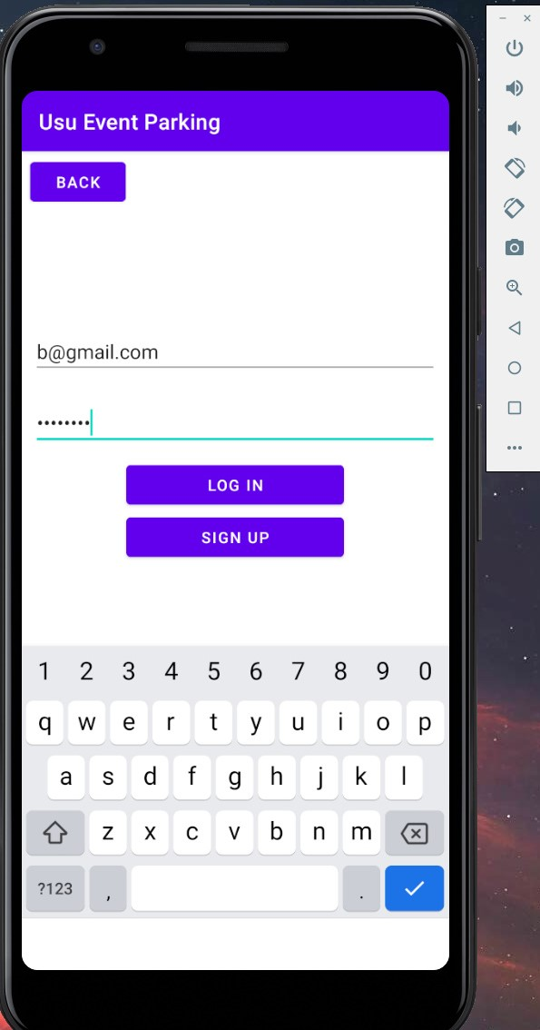
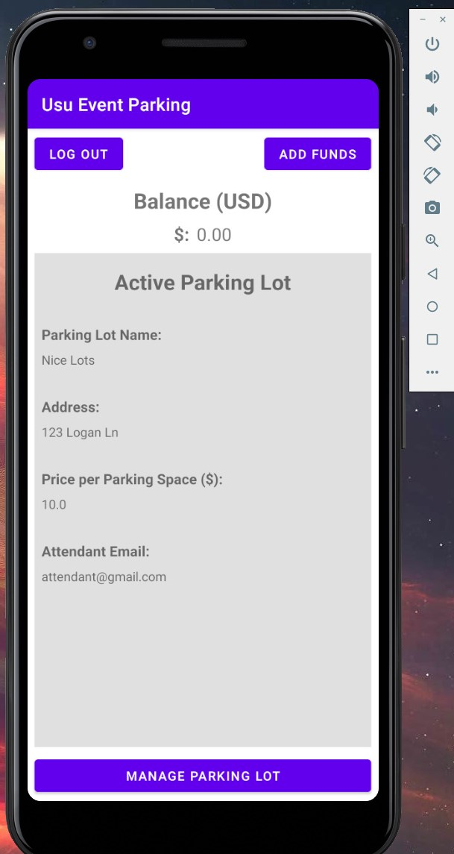
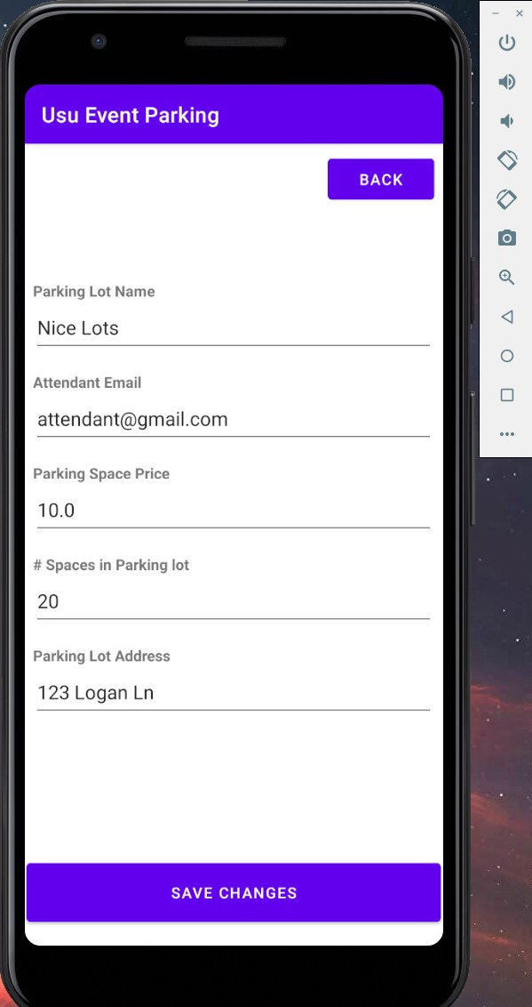
Login OwnerMain ManageLot

Slide 12
Requirement 2
Customers reserving and paying for a parking space

Slide 13
Low-fi and High-fi Design
We started by defining the requirements for customer:
Customers needed to be able to add funds to their account.
Customers needed to be able to find a parking lot to reserve a space
Customers needed to be able to pay for a parking space.
Customers would not be allowed to reserve multiple parking spaces at once.
We created a low-fi drawing of the android activities that the customer needed to have to find, reserve a parking space, and cancel their reservation.
We then designed the methods that would need to be created to allow the customer to enter new info into the app and put the customer data and reservation into the database.
Lastly, we designed the methods to query data from the database to display the customer's reservations and relevant data.

Slide 14
Development and Scrum Meetings
Development Tasks:
Design and develop customer activities - (Assigned to: Brandon and Kaleb)
Designed all activities and classes that would need to be created to allow customers to reserve parking spots.
Activity to allow users to find valid parking lots - Brandon
Created CustomerFindLotActivity and CustomerConfirmLotActivity classes.
Customer reservation functionality - (Assigned to: Brandon and Kaleb)
Created button to launch CustomerFindLotActivty from CustomerMainActivity. After selecting a parking lot to reserve a space in, take user to CustomerConfirmLotActivity.
Load customer data from database to customer activity - (Assigned to: Kaleb)
Load data into CustomerMainActivity, and ConfirmLotActivity classes from database, which then displayed relevant information to the app user.
Button to cancel customer reservation - (Assigned to: Kaleb)
Remove created deleteReservation() method inside UserViewModel class to remove the customer’s reservation both in the app and in the database
Add Payment functionality to pay owner upon successful reservation - (Assigned to: Kaleb)
Created methods payAttendant(), payOwner(), updateDevBalance(), and updateUserBalance() to both pay the owner of the parking lot and take a cut of the transaction for the developers of the app
Scrum Meetings:
In our scrum meetings, Brandon and Kaleb determined which tasks needed to be completed first and who would work on each.
Brandon focused primarily on developing the front end code such as the UI while Kaleb worked primarily on pushing and querying data from the database.
Unit Testing: - Since JUnit4 would not exactly work to catch errors effectively, the team took a more hands on approach to testing the integrity of the code.
Added messages that would display information being passed to app.
Added code to terminate program and return an error message if invalid behavior occurred.
Sent messages to UI to display error messages to user.
Tried to cause the app to crash by entering invalid data and cause unintended app activity when running application

Slide 15
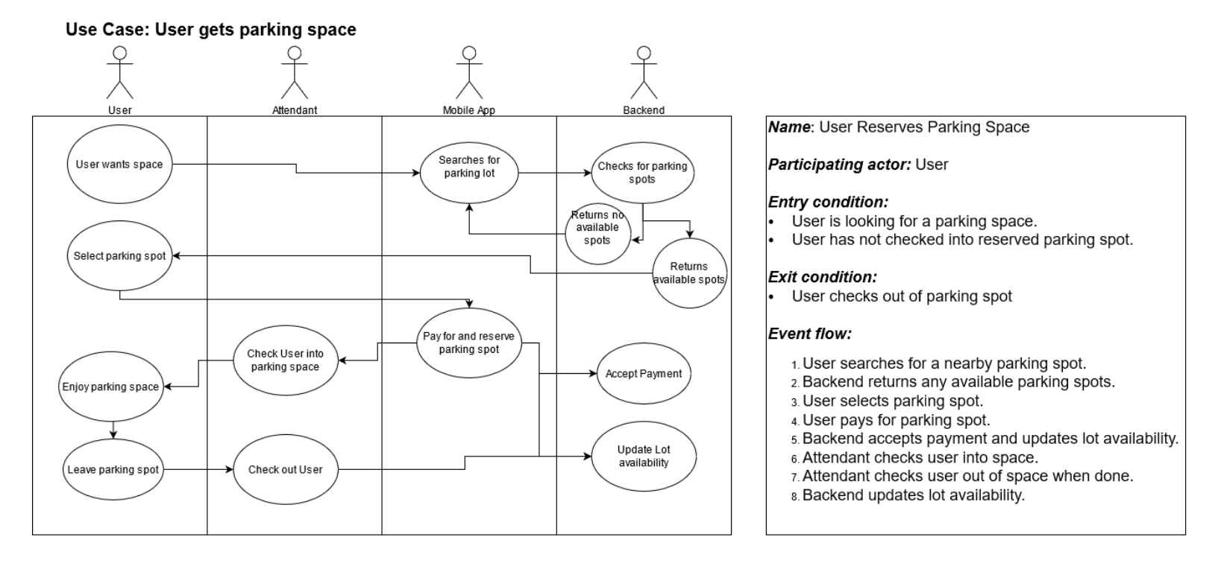
Use case Diagram/UML

Slide 16
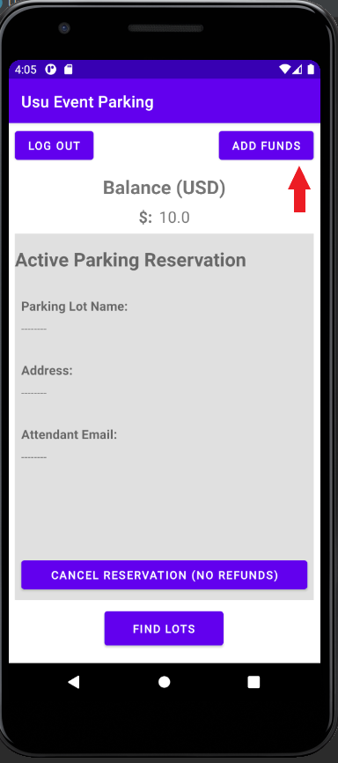
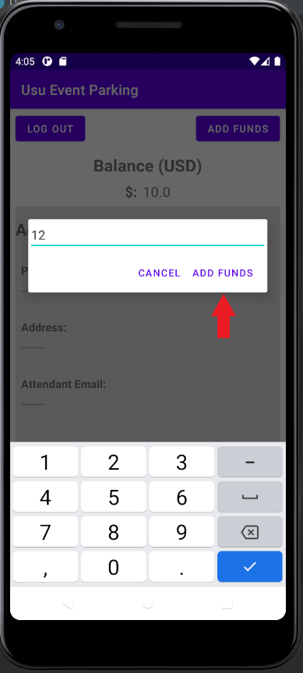
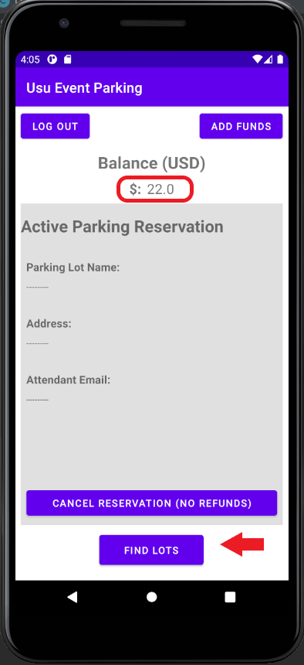
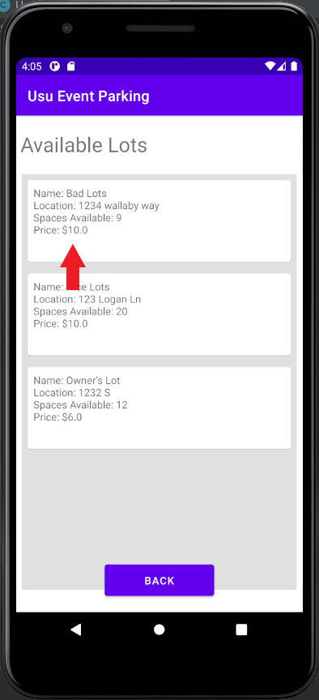
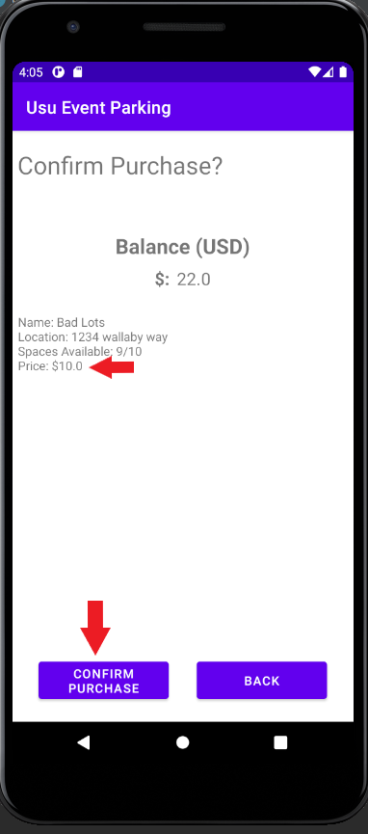
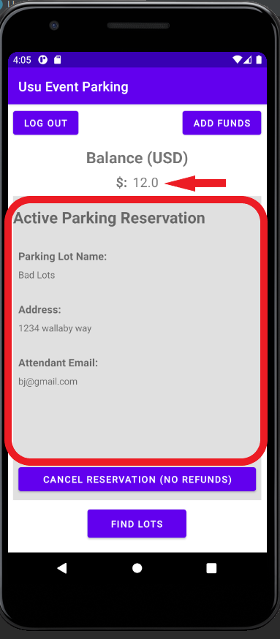
Show reservation and updated balance
Customer Main
Add funds
Updated balance
Select lot to reserve space
Confirm lot reservation

Slide 17
Requirement 3
Attendants checking customers in and out of parking spaces

Slide 18
Low-fi and High-fi Design
We started by defining the requirements for the Attendant:
Attendants needed to be able to Check in/out Customers.
We thought about adding a QR code to easily check in Customers.
We knew that for simplicity we wouldn’t be able to take cash payments because Attendants would not be able to get paid a percentage.
Attendants being able to check Customers in and out of parking spaces is core feature that came from the requirements gathering portion of our project.
We knew we would need an Attendant User to help implement this feature which forced us to plan our app around another type of user.
In order to plan around the Attendant User effectively, we created a Use Case Diagram and wrote out an Event Flow to determine what features would need to be implemented.
The most difficult part was determining how the Attendant would interact with the Database to update or store information.

Slide 19
Development and Scrum Meetings
Development Tasks:
Design and develop Attendant Activities - (Assigned to: Brandon and Kaleb)
We developed two activities, Attendant Main and Check In Check Out, to allow Attendants check customers in or out.
Buttons to transfer between the activities - (Assigned to: Brandon)
Created the checkIn button to launch the CheckInCheckOut activity and the returnToAttenMain button to go back to the Attendant Main activity.
Allowing Attendant to Check in Customer - (Assigned to: Brandon and Kaleb)
Create a recycler view that allows Attendants to check in users by ID. Created a confirmation button to check Customer in and a back button to return to the Check In Activity. Also added the functionality that when Attendants check in users they receive 10% of the of payment.
Load reservation data from the database to the Attendant Main Activity - (Assigned to: Kaleb)
Retrieve the data from the database to display.
Button to logout of user account - (Assigned to: Brandon)
Created a button that can take the user back to the login screen and secure the sensitive user information.
Keep track of Attendant account balance - (Assigned to: Kaleb)
Created a textView that displays the most current owner account information in dollars.
Scrum Meetings:
In our scrum meetings, we discussed how to utilize the Google Firebase database to best update Customers when they check in and the balance of the attendants. We also talked about how to best implement and split up the various interactive components (buttons, edit text fields) between the two activities.
Unit Tests: - Since JUnit4 would not exactly work to catch errors effectively, the team took a more hands on approach to testing the integrity of the code.
Added messages that would display information being passed to app.
Added code to terminate program and return an error message if invalid behavior occurred.
Sent messages to UI to display error messages to user.
Tried to cause the app to crash by entering invalid data and cause unintended app activity when running application

Slide 20
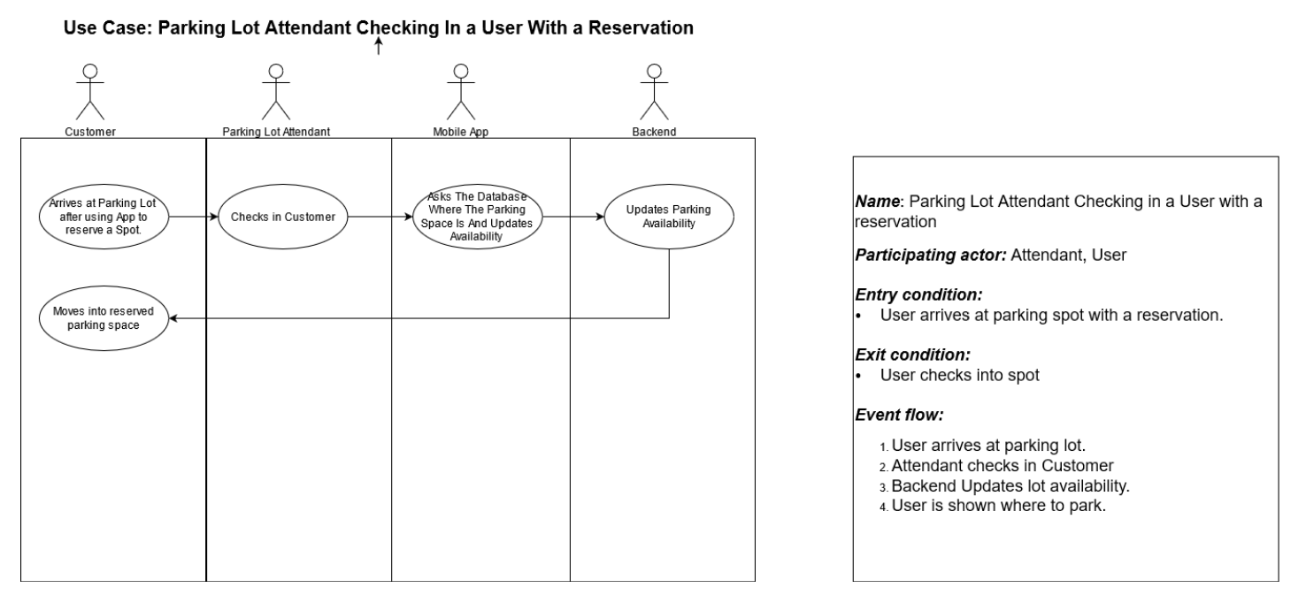
Use case Diagram/UML

Slide 21
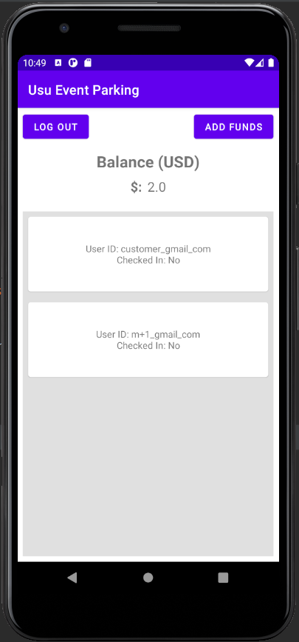
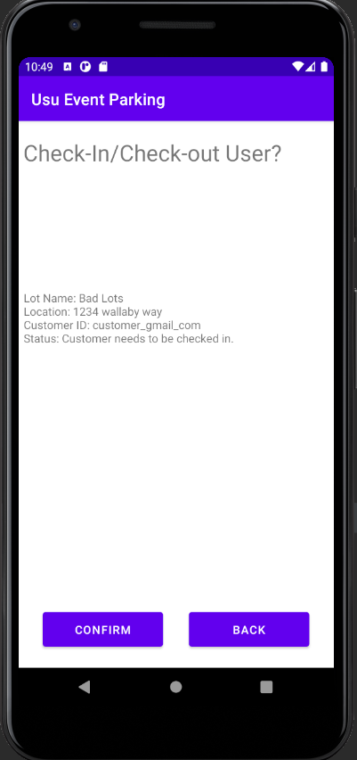
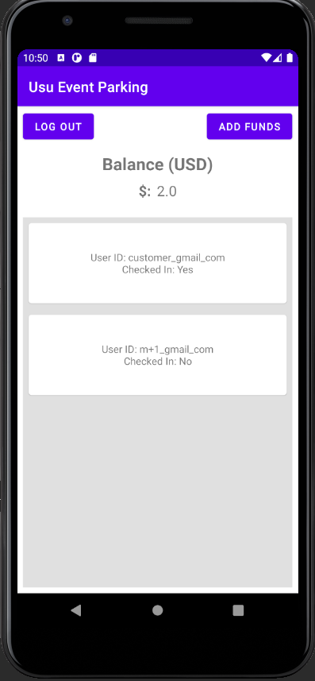
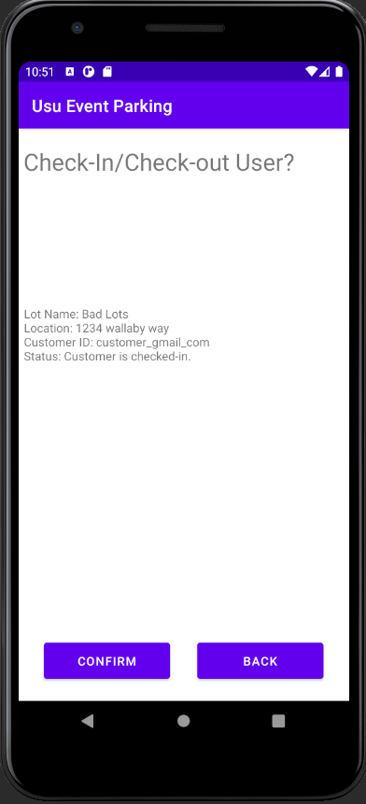
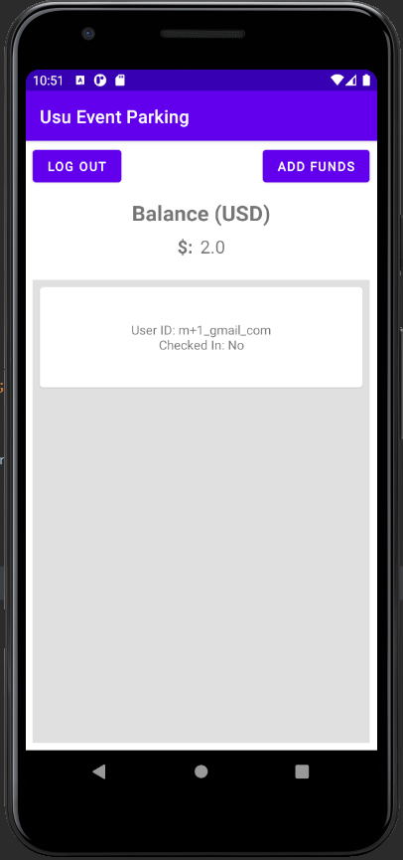
Attendant Main
Attendant Checking in Customer
Customer Checked in
Customer Checked Out
Customer Removed and Balanced Updated

Slide 22
Resources
Atlassian. (n.d.). Trello. https://trello.com/.
GitHub Inc. (n.d.). Github. GitHub. https://github.com/.
Google. (n.d.). Andriod Studio. Android Developers. https://developer.android.com/studio.
Google. (n.d.). Firebase Documentation. Firebase.Google.com. https://firebase.google.com/docs/reference/android/com/google/firebase/auth/package-summary.
Spreadsheet Bootcamp. (2020, October 7). Excel Burndown Chart Template. Automate Excel. https://www.automateexcel.com/charts/burndown-template.
How to separate two different user in firebase android app? Stack Overflow. (2017, April 9). https://stackoverflow.com/questions/43312896/how-to-separate-two-different-user-in-firebase-android-app.
How to listen for Firebase setValue completion. Stack Overflow. (2017, October 19). https://stackoverflow.com/questions/46829749/how-to-listen-for-firebase-setvalue-completion.
What is firebase and how to use it in Android? Stack Overflow. (2015, November 15). https://stackoverflow.com/questions/33720614/what-is-firebase-and-how-to-use-it-in-android.

Slide 23
Questions?

